Slide 1
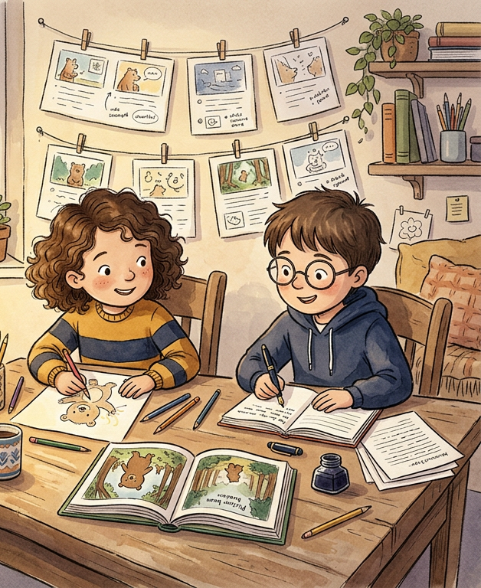
LEVARE HOUSE PUBLISHING
Children's Book
Internship
A zero-cost, credit-ready industry partnership for illustration and creative writing students
Presented by John C. Cusimano, Founder & Publisher
Carlo J. Levare is a pen name of John C. Cusimano.
© 2026 Levare House Publishing. Copyright held by John C. Cusimano and Levare House Publishing. All rights reserved.

Slide 2
THE OPPORTUNITY AT A GLANCE
$0 to the university. Real projects for students.
$0
15
2
1
Cost to the university. The publisher covers mentorship, projects and evaluation.
Weeks. A structured semester aligned to the academic calendar.
Departments served: Art / Illustration and Creative Writing.
Published title already: Finn the Forgetful Fish.
The internship places students on live children's book projects, fully remote and flexible, with academic credit for the work. No new budget is required.
© 2026 Levare House Publishing. Copyright held by John C. Cusimano and Levare House Publishing. All rights reserved.
2

Slide 3
PROOF OF CONCEPT
Finn the Forgetful Fish is already on sale.
The book
The student contribution
A children's book about childhood anxiety, combining creative excellence with social impact.
Co-written by John C. Cusimano and Rose Cox.
Available now on Amazon and Barnes & Noble.
Rose Cox, then an undergraduate at the University of Colorado Colorado Springs, contributed all of the original artwork under professional editorial guidance.
The result is commercially viable, publication-ready work.
© 2026 Levare House Publishing. Copyright held by John C. Cusimano and Levare House Publishing. All rights reserved.
3

Slide 4
PROVEN MODEL
Students have already been paid and credited.
Commissioned directly
Why we offer both
Rowan Niewald, then an undergraduate at Metropolitan State University of Denver, was commissioned directly, paid for the work, credited on the cover, and kept her copyright.
Students can choose credit or a paid commission.
The internship gives academic credit rather than a fee.
A student who would rather be paid can be commissioned instead.
The two paths run side by side, so students and universities can choose what fits.
© 2026 Levare House Publishing. Copyright held by John C. Cusimano and Levare House Publishing. All rights reserved.
4

Slide 5
CROSS-FUNCTIONAL MODEL
One partnership, two departments.
Art and Illustration students
Creative Writing students
Create original character designs, page spreads and cover art for live publishing projects.
Build a professional portfolio with published work credits.
Use the university's imaging software, such as Adobe Creative Cloud or Canva Pro.
Draft and revise children's book manuscripts under editorial mentorship.
Experience the full editorial cycle, from developmental edits to final proofing.
Collaborate with illustrators on text and image integration.
Run independently or together
Each track can run on its own. Both tracks can also run together as one combined department program.
© 2026 Levare House Publishing. Copyright held by John C. Cusimano and Levare House Publishing. All rights reserved.
5

Slide 6
SHARED RESPONSIBILITIES
Publisher and university roles
Levare House Publishing provides
The university provides
Real children's book projects in active development, not simulations.
A dedicated publisher mentor for weekly guidance and feedback.
Formal midterm and final performance evaluations.
A letter of recommendation for each student who completes the program.
A freelance illustrator or practicum agreement that sets out deliverables and IP terms.
A faculty supervisor for academic oversight and credit approval.
Standard imaging software access, such as Adobe Creative Cloud or Canva Pro.
Student enrollment and credit-hour administration.
Participation in the midterm review and capstone panel.
© 2026 Levare House Publishing. Copyright held by John C. Cusimano and Levare House Publishing. All rights reserved.
6

Slide 7
LEADERSHIP AND LONG-TERM MODEL
Levare House’s role and how they are paid
Levare House Publishing's role at the university
How book sale proceeds are split
Levare House Publishing's long-term compensation
Faculty liaison and program lead.
Adjunct instructor for participating students.
Advisor to participating departments.
70% of book sale proceeds goes to charitable and industry development programs. Invisible Disabilities Association is in discussion.
30% covers the administrative costs of running the program.
Students are credited for their work. They are not paid from the proceeds.
After the first successful internship: salary or per-course fees from the university.
© 2026 Levare House Publishing. Copyright held by John C. Cusimano and Levare House Publishing. All rights reserved.
7

Slide 8
COMMUNITY IMPACT
Royalties support charity and nonprofits
70%
30%
Why it matters to your university
of book royalties goes to charitable and/or nonprofit organizations.
covers the administrative costs of running the program.
The nonprofit component supports grant applications and community-impact reporting.
It aligns the program with the university's public-service mission.
Current partner: Invisible Disabilities Association (in discussion). Additional partners will be confirmed.
© 2026 Levare House Publishing. Copyright held by John C. Cusimano and Levare House Publishing. All rights reserved.
8

Slide 9
PROGRAM STRUCTURE
A 15-week structure with clear milestones
WEEKS 1 TO 5
Foundation
WEEKS 6 TO 10
Development
WEEKS 11 TO 15
Capstone
• Onboarding and orientation
• Agreement signing and IP terms
• Market research and genre study
• Concept development
• Initial faculty checkpoint
• Full production
• Midterm portfolio review with faculty and publisher
• Revision cycles and editorial feedback
• Text and image integration
• Pre-press file preparation
• Portfolio assembly
• Capstone presentation to a faculty and publisher panel
• Letter of recommendation issued
© 2026 Levare House Publishing. Copyright held by John C. Cusimano and Levare House Publishing. All rights reserved.
9

Slide 10
WHY THIS MATTERS FOR THE UNIVERSITY
Strategic benefits aligned to institutional priorities.
Zero new budget
Accreditation value
Student employability
All publisher-side resources are provided at no cost. The university uses existing faculty and software.
Active industry partnerships are a key metric in program accreditation reviews, showing real-world curriculum integration.
Graduates leave with a professional portfolio, a published credit and a letter of recommendation from an active publisher.
Scalable and remote
Multi-department impact
The fully remote format lets students participate from any campus, with no facility requirements.
One partnership serves Art, Illustration and Creative Writing, multiplying the return on one agreement.
© 2026 Levare House Publishing. Copyright held by John C. Cusimano and Levare House Publishing. All rights reserved.
10

Slide 11
WHAT WE HAVE BUILT
The program is ready to launch with a partner.
Public website with internship, universities and commission pages, plus a live contact path
A single application form that covers both the illustration and creative writing tracks
Printable flyers for each track, with QR codes for students
Faculty review process in Microsoft Forms, with a written review guide
Admission rubrics for both tracks, scored 0 to 4 on a 100-point scale
Commission path for independent illustrators and writers
© 2026 Levare House Publishing. Copyright held by John C. Cusimano and Levare House Publishing. All rights reserved.
11

Slide 12
WHERE WE ARE
Current status, and what a partner receives.
Current status
What a partner university gets
Applications for future internship opportunities are open.
The first cohort has not yet been placed. We are looking for a partner university to launch it.
Finn the Forgetful Fish is published and available now.
A zero-cost program with a published-book track record.
A faculty supervisor who keeps academic control of credit.
A structure that scales from one student to a small cohort each semester.
© 2026 Levare House Publishing. Copyright held by John C. Cusimano and Levare House Publishing. All rights reserved.
12

Slide 13
NEXT STEPS
Three simple steps to launch the partnership.
1
Designate a faculty supervisor
Identify one faculty member per participating department as the academic liaison.
2
Confirm credit eligibility
Review the internship structure against your institution's practicum or independent study credit requirements.
3
Schedule a partnership meeting
A brief introductory call with department leadership, at your convenience.
© 2026 Levare House Publishing. Copyright held by John C. Cusimano and Levare House Publishing. All rights reserved.
13

Slide 14
CONTACT
Let's talk about a first cohort.
John C. Cusimano, Founder & Publisher, Levare House Publishing
Website: LevareHouse.com
Email: John@LevareHouse.com
Copyright notice
© 2026 Levare House Publishing. Copyright in this presentation, including its text, layout and images, is held by John C. Cusimano and Levare House Publishing. All rights reserved.
No part of this presentation may be reproduced, distributed or used without prior written permission, except for brief quotations in a review.
Carlo J. Levare is a pen name of John C. Cusimano.

